Slide 1





CUSTOMER CHURN ANALYSIS
IN BANKING Industry
MKT 869 Machine Learning for Marketing With Python
Professor: Robert Smith
The Boosted Bandits:
Artem Aloian, ChihChung Wang,
KuanMing Su, Yen Nguyen

Slide 2

Agenda
Part 1. Overview our research
Part 2. Exploratory Data Analysis
Part 3. Feature Engineering
Part 4. First model performance
Part 5. Comparative Analysis - Final Model Selection
Part 6. Key relationships
Part 7. Summary

Slide 3




Part 1: Overview our research
Banking Industry
Target Column
Dataset Overview
Business Questions

Slide 4

Banking Industry
In today’s competitive banking world, keeping customers loyal is key.
Customer churn is a major challenge: churn rates average 20-25% annually, but retaining them is often more cost-effective than finding new ones.
By understanding why customers leave, banks can create smarter strategies to boost loyalty and reduce churn.

Slide 5

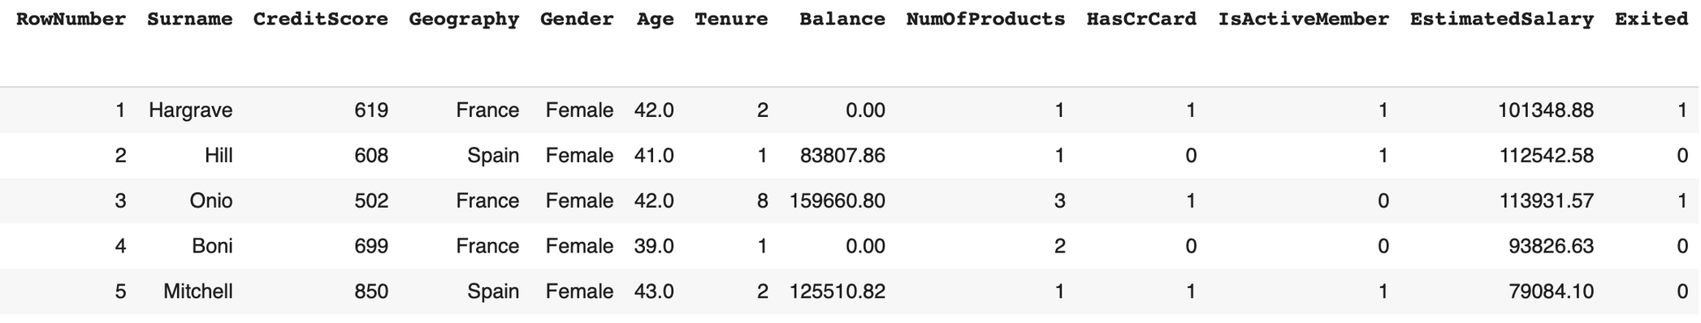
Dataset Overview
Data shape: 10000 rows, 14 columns

Slide 6

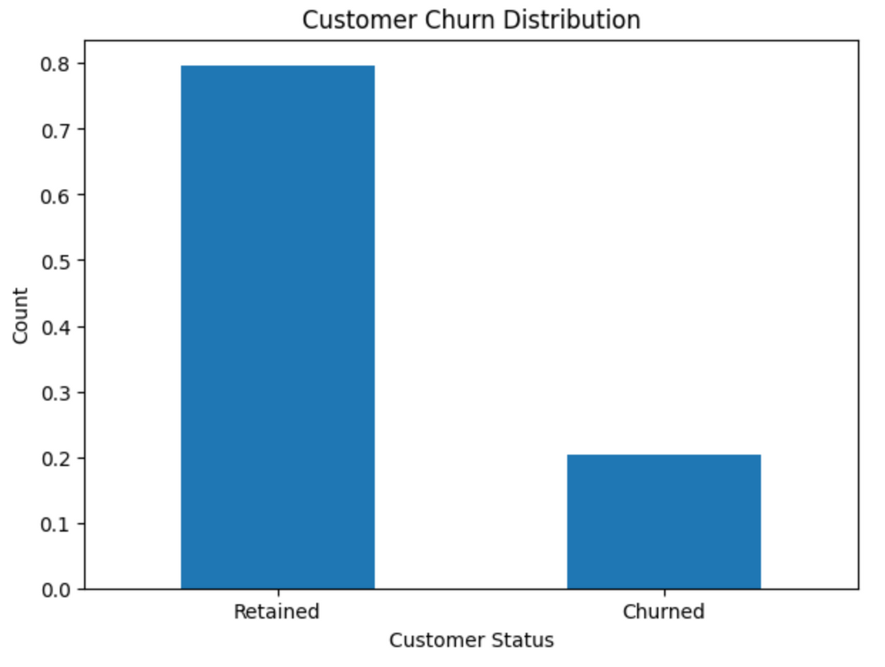
Target Column
Exited:
0 means a bank customer stayed.
1 indicates a bank customer left.
Churn rating 20%

Slide 7

Business Questions
What demographic and financial factors have the strongest correlation with customer churn?
How accurately can machine learning models predict client churn?
Are there any particular strategies to reduce customer attrition based on the responses to the first two questions?

Slide 8
Part 2: Exploratory Data Analysis
Feature Selection
Categorical Features
Numeric Features
Visualizing Exited with other features

Slide 9

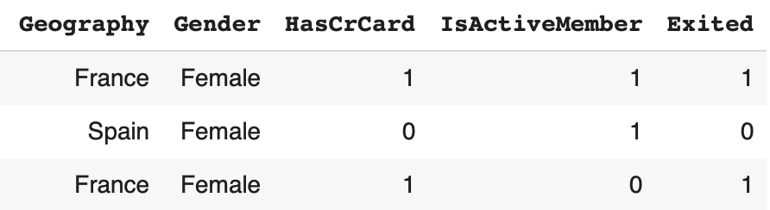
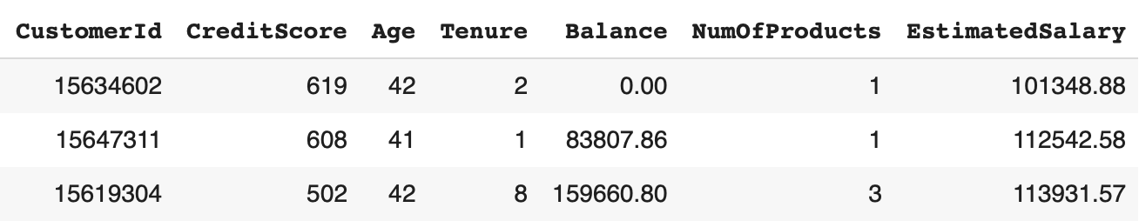
Feature Selection
Drop [RowNumber, Surname, CustomerId] columns.
Separate categorical and numeric features.
Notes:
some numerical features has binary values 0 and 1, it should be classified in categorical featues. Syntax do it:
# Divided into numerical and categorical features.
numeric_df = df.select_dtypes(include=['int64', 'float64'])
dummy_vars = []
for col in numeric_df.columns:
if df[col].nunique() == 2:
dummy_vars.append(col)
numeric_df = numeric_df.drop(columns=dummy_vars)
categorical_df = df.drop(columns=numeric_df.columns)
print("Potential dummy variables:", dummy_vars)
# Result
print("Numeric Features:")
numeric_df.head()

Slide 10
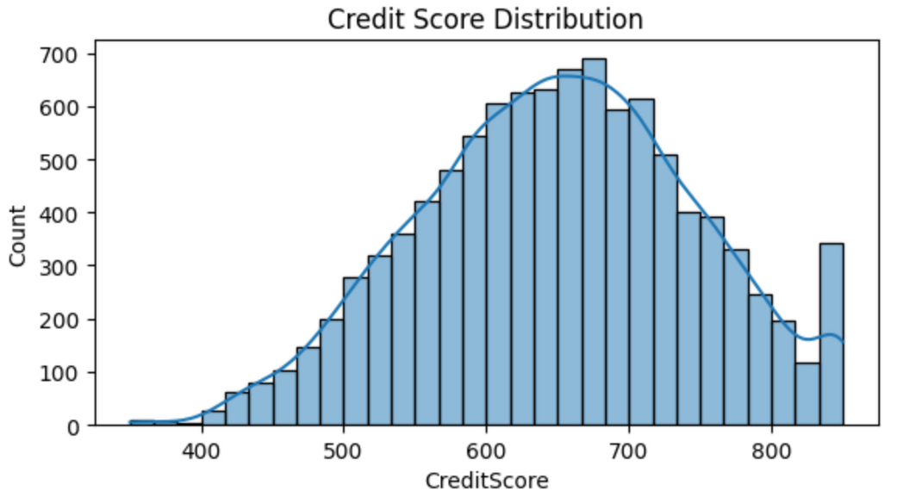
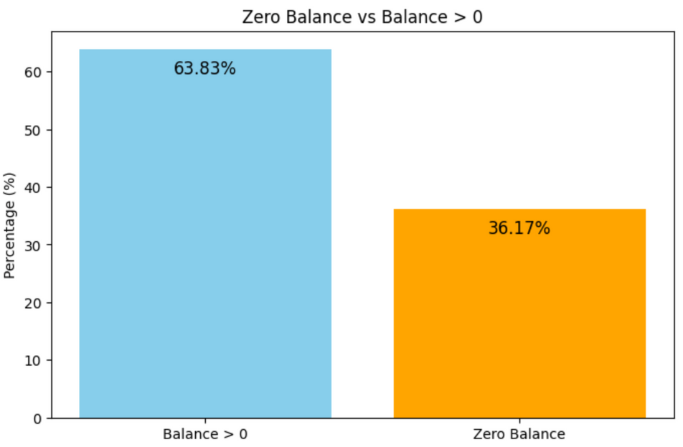
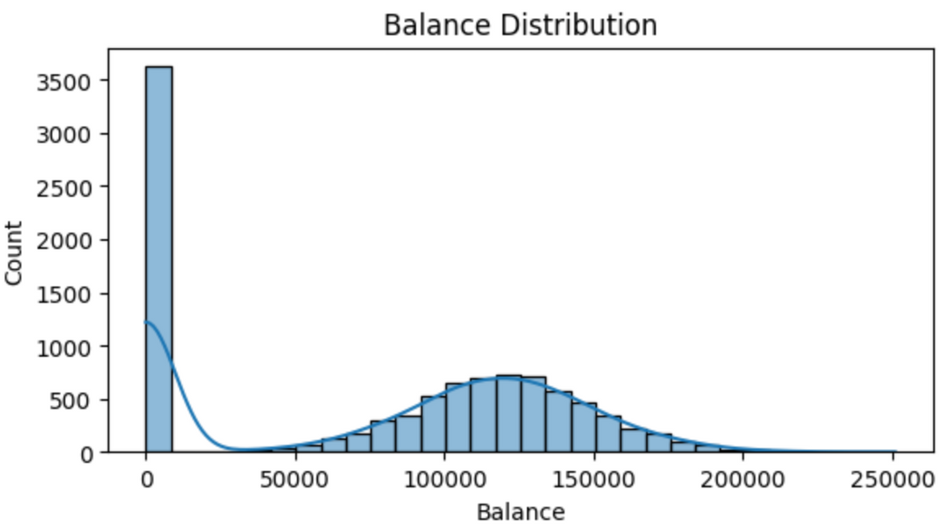

Numeric Features
Credit Scores: balanced distribution, primarily between 500 and 750.
Balances:
Around 63.83% of customers have a positive balance.
Active balances typically cluster around 100,000.
Notes:
-Count: The total number of records for each feature.
-Mean: The average value, giving us an idea of the central tendency.
-Min and Max: These represent the range of values, showing the smallest and largest observed numbers.
-Standard Deviation: This measures how spread out the values are around the mean, see the variability within the data.

Slide 11
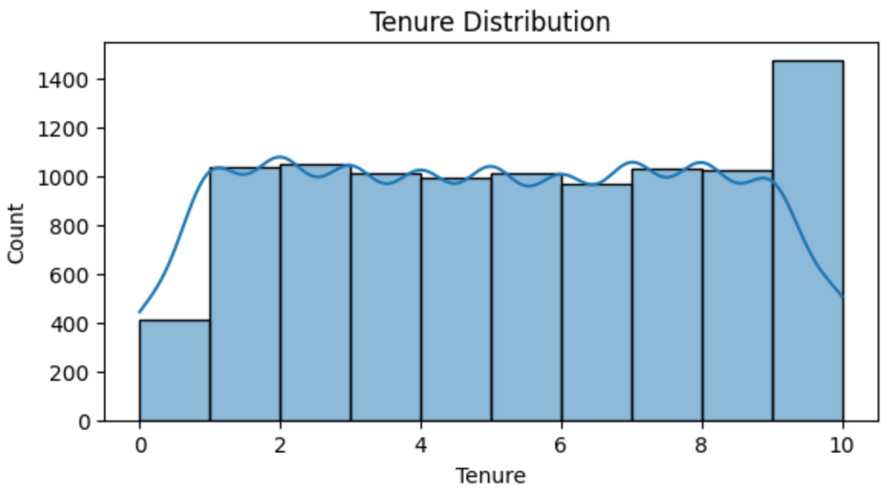
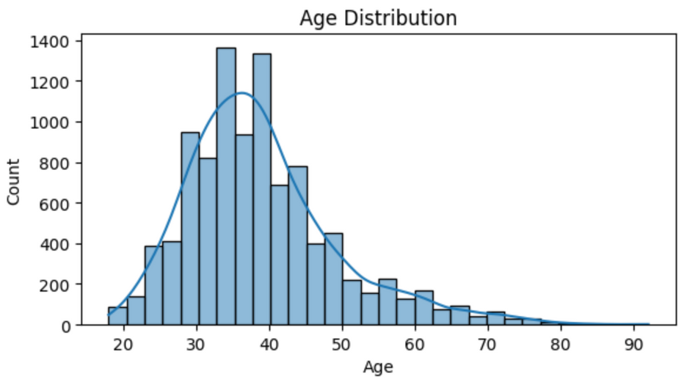
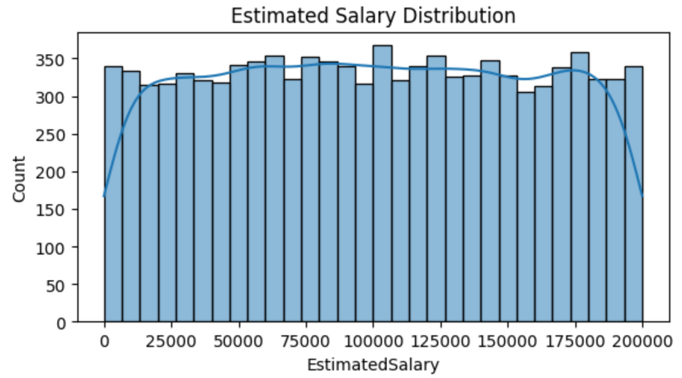
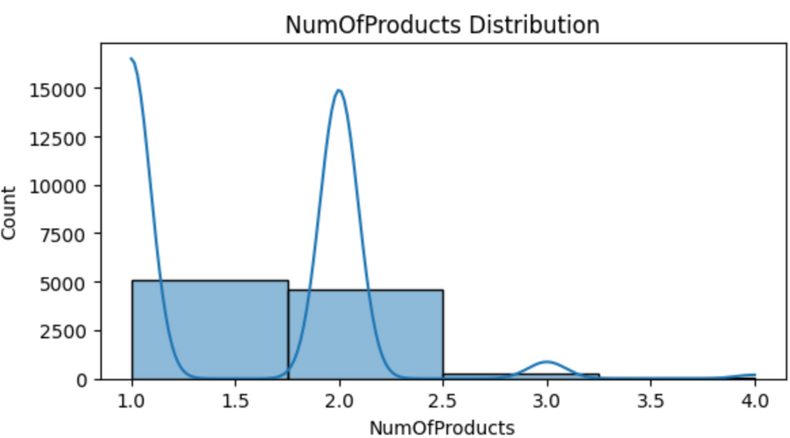
Many customers have long tenure, with a peak at 10 years
The majority are mid-aged, between 30 and 40 years old
Salaries are spread out evenly, showing a mix of income levels
Product adoption is low, with most customers holding just 1–2 products

Slide 12
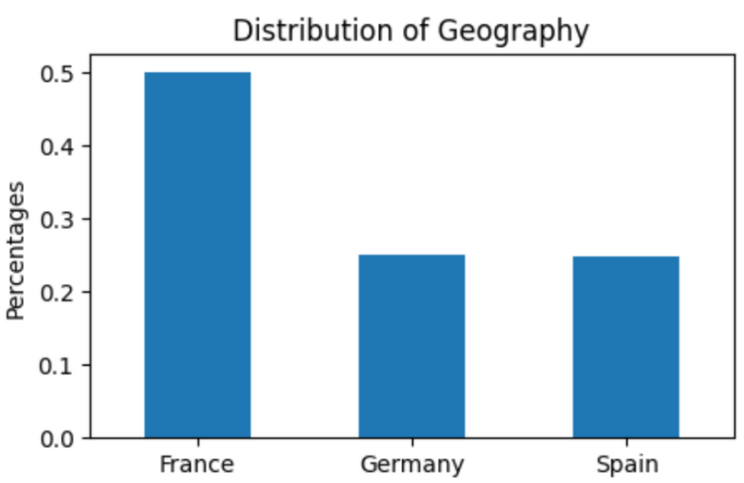
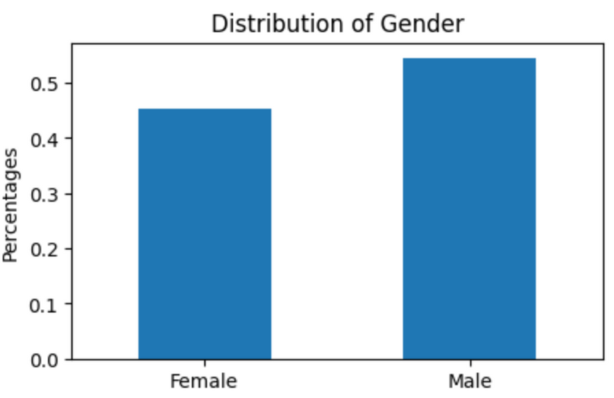
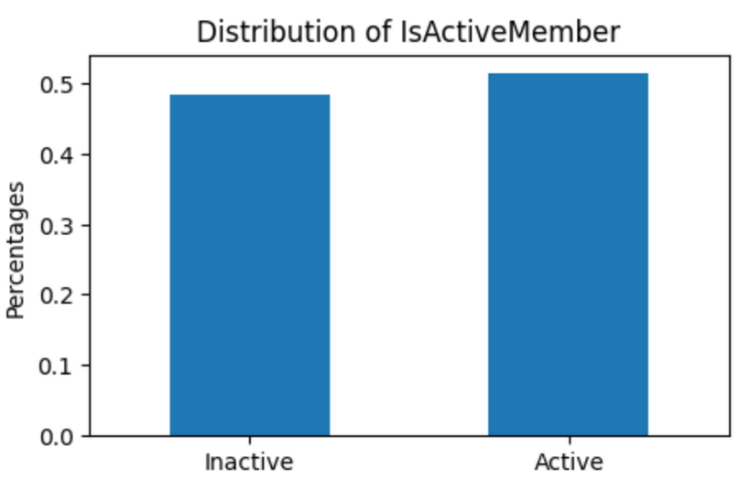
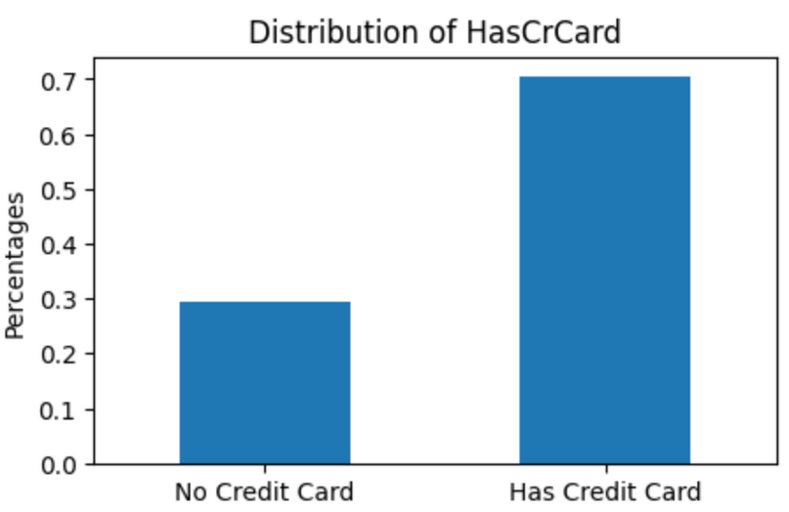
Categorical Features

Slide 13
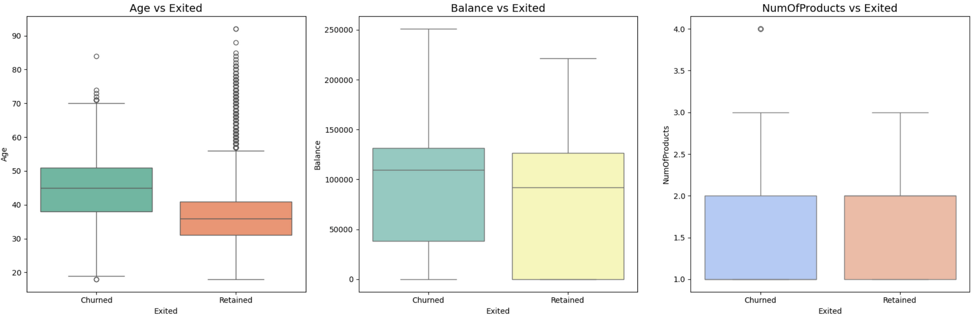
Visualizing Exited with other features
Balance and Churn
High-balance customers tend to churn more.
Age and Churn
Older customers (50+) are more likely to churn.
Younger customers (30-40) are more likely to stay
Number of Products and Churn:
Customers with 1-2 products are at higher churn risk.
“Older customers may feel less satisfied or engaged with the current services.”
“Customers with limited product adoption are less involved or connected with the bank.”
Notes:
Why We Focused on Age, Balance, and Number of Products
Strong Correlation to Churn
During our exploratory analysis and statistical tests, Age, Balance, and Number of Products showed a significant relationship with the target variable Exited (churn).
These features have clear patterns that help us understand customer behavior and churn risk.
Older customers need personalized retention efforts.
High-balance customers require better engagement strategies.
Low product adoption calls for stronger cross-selling initiatives.

Slide 14
Part 3: Feature Engineering
Missing value
Remove Outliers
Correlation Matrix
One Hot Encoding & VIF
We did not do features Scaling for our first model

Slide 15
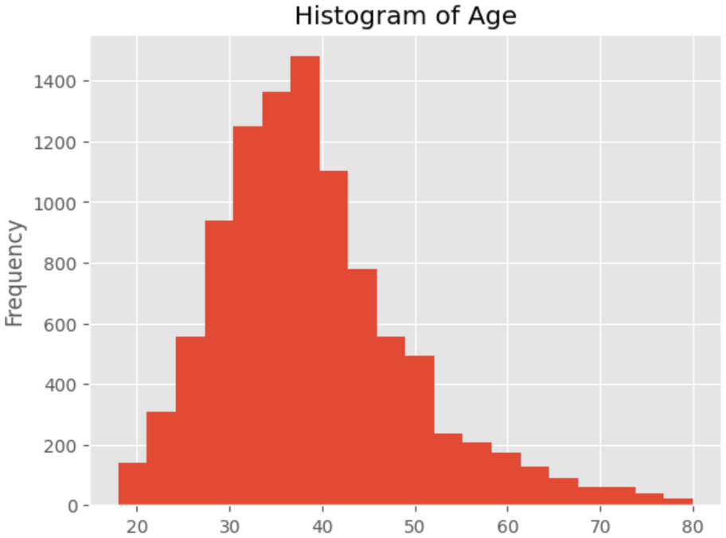
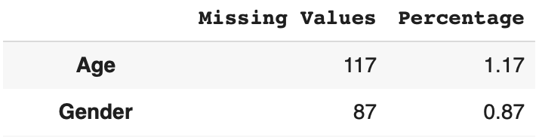
Missing value
Fill in the missing value of age using the mean
Fill in Gender's missing value by mode.

Slide 16
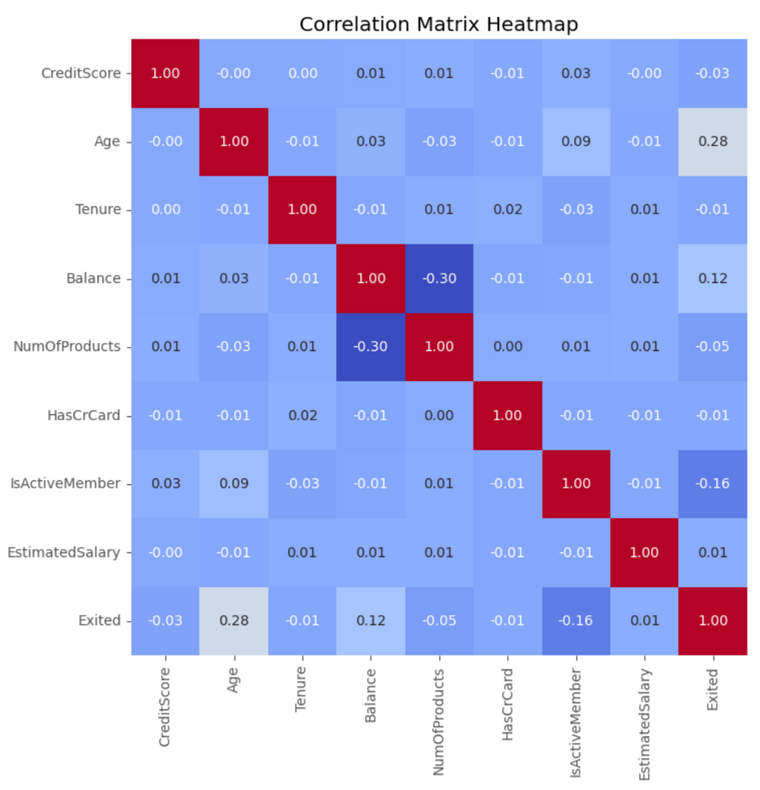
Correlation Matrix
Proposal: Help discover potential multicollinearity by emphasizing strong positive or negative connections between variables.
The correlation heatmap shows that most features have low correlation coefficients, implying few linear correlations.
A moderate positive correlation between Age and Exited suggests older consumers are slightly more likely to leave.

Slide 17

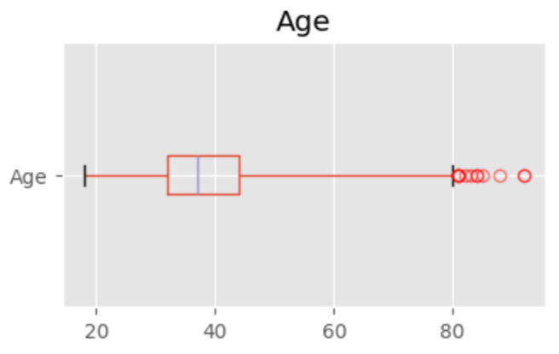
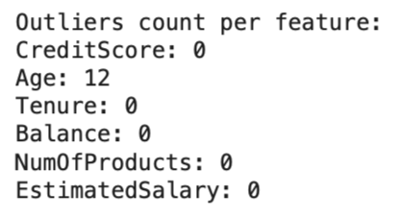
Remove Outliers
Only 12 outliers in Age feature
Applying Listwise Deletion

Slide 18
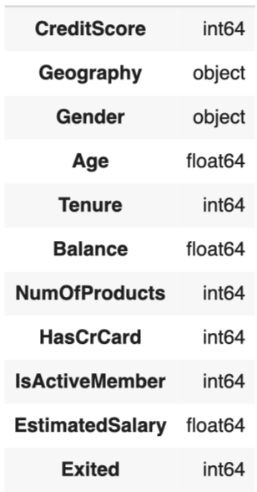
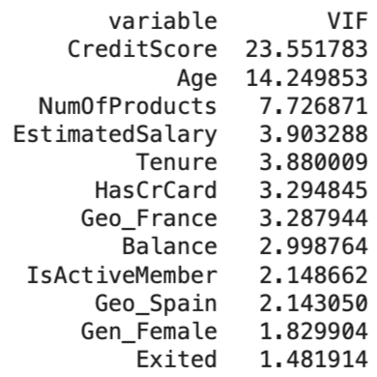
One Hot Encoding & VIF
Geographic and gender are strings, thus we apply one hot encoding to convert them to dummy variables.
CreditScore and Age have higher VIF, but We are not remove them, because they all represent a separate dimension for the customer.

Slide 19
Part 4: First model performance
Building Logistic regression model
Model Result

Slide 20

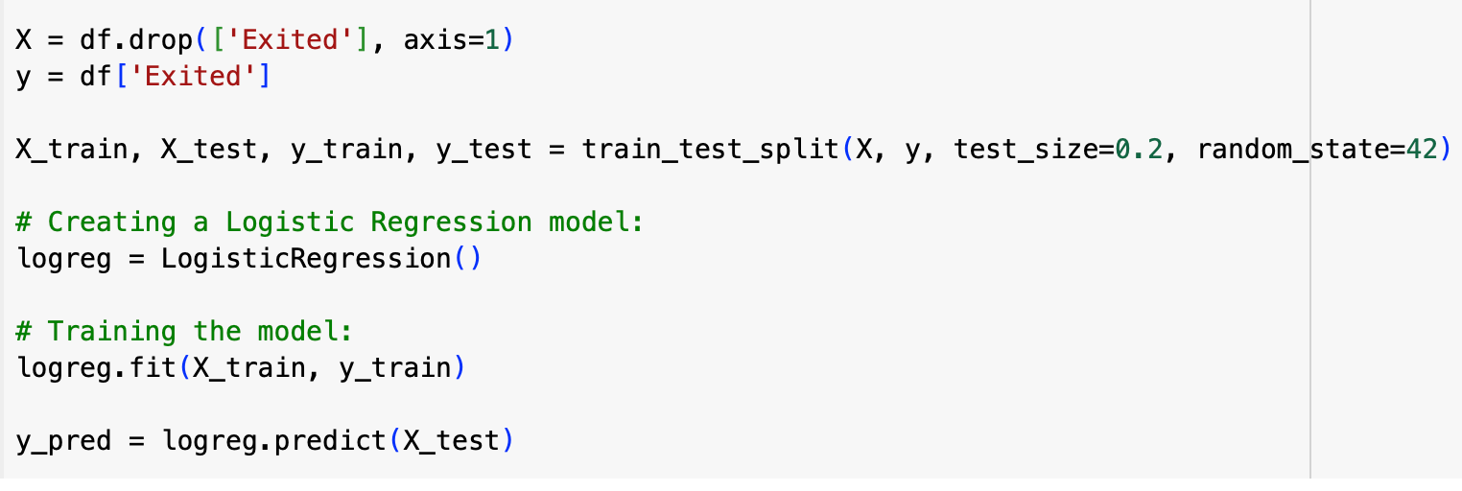
Predictive model result
80% training data, 20% testing data
Build Logistic Regression model

Slide 21
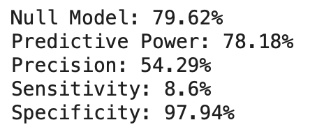
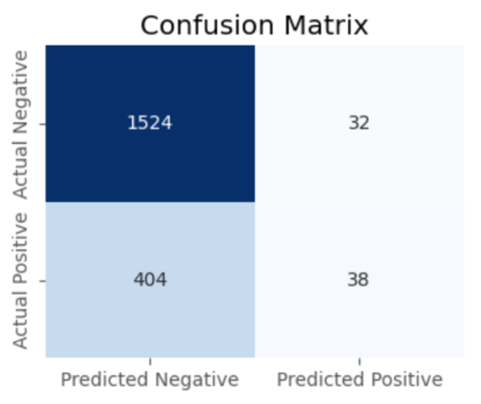
Model Result
The model successfully identifies non-churners (high specificity, 97%).
It fails to accurately identify churners (8% sensitivity), which is crucial for churn prediction tasks.
Precision (54.29%) indicates moderate performance in correctly identifying favorable predictions.

Slide 22
Part 5: Comparative Analysis
Improvement direction
Improve model
Key relationships

Slide 23
Improvement direction
Our target customers are predicted positively.
The company's budget are limited, so we plan for using them accurately on our target customers.
Therefore, boosting our precision rate is the top priority.

Slide 24

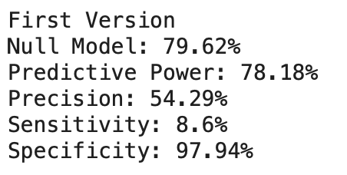
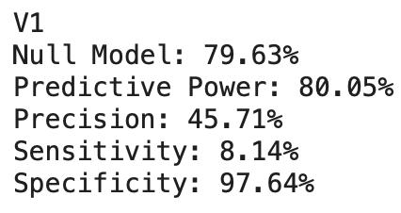
Improvement model
First model
Missing value: mean-imputation way
Outliers: Listwise Deletion
Features scaling: NO
Version 1
Missing value: mean-imputation way.
Outliers: Winsorization
Features scaling: NO

Slide 25
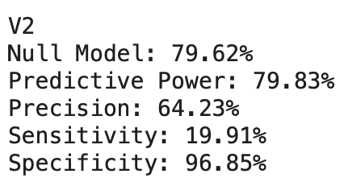
First model
Missing value: mean-imputation way
Outliers: Listwise Deletion
Features scaling: NO
Version 2
Missing value: mean-imputation way
Outliers: Listwise Deletion
Features scaling: Yes

Slide 26

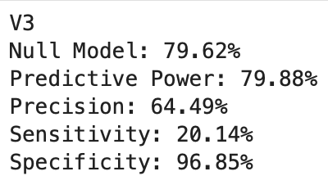
Version 2
Missing value: mean-imputation way
Outliers: Listwise Deletion
Features scaling: Yes
Version 3
Missing value: Regression-imputation way
Outliers: Listwise Deletion
Features scaling: Yes

Slide 27
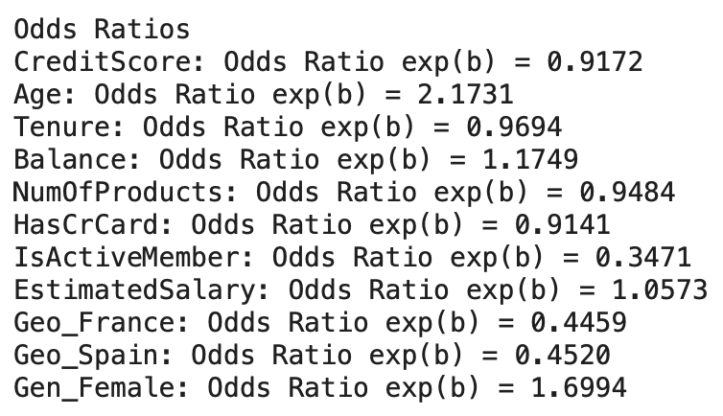
Key relationships
Older customers are more likely to churn
Female customers are more likely to churn.
Active members are less likely to churn
Customers from France and Spain are less likely to churn
Higher balance and salary slightly increase the likelihood of churning
Higher credit scores and holding more products are linked to lower churn likelihood.
Notes:
greater than 1: high rate to churn
less than 1:

Slide 28
Summary
Q1 What are the strong factors?
Factors that increase churn: Age, Female customers.
Factors that decrease churn: Active membership, customers from France and Spain.
Q2 How is accuracy of our model?
Overall accuracy(79.83%) is barely better than the null model.
Still need to improve the identification of positive cases.
Q3 Business suggestion
1.Model Improvement:
Explore alternative models like Random Forest to better identify churn cases and improve predictive accuracy.
2.Resource Allocation:
Focus on expanding and retaining the consumer base in regions like France and Spain, where churn is lower.
3.Targeted Engagement:
Develop strategies to increase participation and retention among women and older customers, as these groups are at a higher risk of churn.

Slide 29

PRESENTATION - 12.16.2024
THANK YOU
FOR YOUR ATTENTION

